Slide 1


Bank analytics
Group 5

Slide 2
Presented by
Farheen
Anishmita
Mobin
Srujana
Vishal
Sahil
Naveen

Slide 3
Agenda
INTRODUCTION
DATA OVERVIEW
OBJECTIVES: KPIS
PROCESS
ANALYSIS
RECOMMENDATIONS AND INSIGHTS
CONCLUSION
DASHBOARD

Slide 4
INTRODUCTION
Our presentation today will walk through a detailed examination of bank loan ,credit and debit analysis of the data. Tracks financial flows with a total transaction volume of 258.89m.
We believe that the data- driven insights are instrumental in making informed decisions ,reducing risk management.
The loan funnel highlights inefficiencies ,making this tool essential for assessing portfolio health, minimizing risks and refining lending strategies of the banking sector.

Slide 5

Data overview
As per the data number of Bank customers ,We are using different types of categories and KPI’s to analyze the data and find out the verified and non verified customer based on the year and interest . We believe that data –driven insight and actionable recommendations for stakeholders in the financial industry.
How payment mode is effected in loan section.
Customer data : Name ,age, location ,account type.
Transaction Data : Deposits , withdrawals, card usage
Loan Data: Applications ,approvals ,repayments, credit scores
Channel Data : Usage of ATM’s mobile apps ,websites , and branches.

Slide 6
OBJECTIVES
Bank loan Analysis Dashboard
The objective of this dashboard is to provide a comprehensive view of loan performance and customer behaviour. By visualizing this data, banks can
Improve loan approval and collection strategies
Support data-driven lending decisions
Identify high risk customers and default patterns
Enhance overall financial risk management
Credit and Debit analysis Dashboard
It helps banks and analysts monitor account activity ,detect unusual behaviour and improve financial decision making
Detect anomalies or suspicious transactions
Support personalized banking services
Track credit and debit transaction volumes and trades
Improve operational efficiency and financial planning

Slide 7

Process
Data cleaning & preparation :Removed duplicates ,fix missing and incorrect entries ,and standardize formats and ensured consistency across datasets.
Data Extraction: Retrieved data from core banking systems ,customer databases and thirdparty sources.
Dashboard Creation: Designed interactive dashboards using power BI/Tableau to visualize KPI’s and share insights with stakeholders.
SQL Queries for Aggregation : SQL was used to extract , join, and aggregate revelant data points from multiple tables for efficient data processing.
Delivered actionable insights to support decision – making in credit scoring ,making strategy , and operational efficiency.

Slide 8
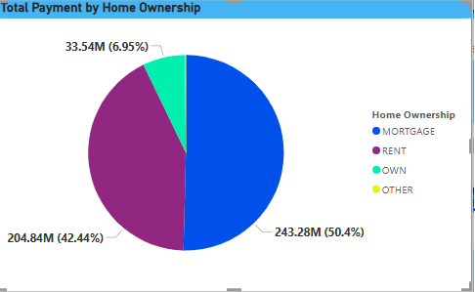
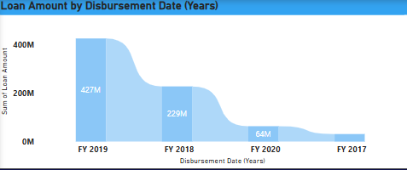
CHARTS
"Loan Amount by Disbursement Date (Years)." It illustrates the total loan amount disbursed by a bank over several fiscal years (FY). The x-axis represents the disbursement years (FY 2017, FY 2018, FY 2019, and FY 2020), and the y-axis represents the sum of the loan amounts in millions (M).
Here's a breakdown of the loan amounts disbursed in each fiscal year:
FY 2019: 427M
FY 2018: 229M
FY 2020: 64M
FY 2017: 37M
"Total Payment by Home Ownership" It illustrates the distribution of total payments made by borrowers, categorized by their home ownership status. The chart displays both the percentage and the absolute value (in millions) for each category.
The key categories and their corresponding payment proportions are:
MORTGAGE: 243.28M (50.4%)
RENT: 204.84M (42.44%)
OWN: 33.54M (6.95%)
OTHER: (No specific value or percentage shown, implying a very small fraction)

Slide 9

Competitive Landscape: Transaction volumes are competitive, with Kotak Mahindra leading the pack.
ANALYSIS
The bank shows strong financial health with a positive net flow ($318.12K) indicating healthy liquidity and substantial customer deposits ($526.08M total account balance).
Transaction activity is high (100.00K volume, 10x account activity ratio), suggesting active customer engagement and stable operations due to balanced debit ($127.29M) and credit ($127.60M) transactions.
Competitive Landscape: Transaction volumes are competitive, with Kotak Mahindra leading the pack.
Transaction Methods: Credit cards show a slight preference, but overall, Bank Transfer, Debit Card, and Credit Card usage is evenly distributed.
Quarterly Trend: A noticeable drop in transaction amounts in Q4 requires immediate investigation to understand the cause.

Slide 10

Loan Portfolio:
Total Loan Amount: 751.0M
Average Interest Rate: 12.03%
Repayment & Recovery:
Total Distinct Payment: 37.87K
Distinct Recovery: 6.52M
Total Payment Invested: 786.5M
Customer Lifetime Value: 814.9M
Financial Performance:
Total Fees Collected: 756.4K
Loan Risk:
Total Delinquent Loans: 7.11K
Highest Defaults: Not Verified Loans
Regional Analysis:
Ludhiana leads in Loan Amount; Hisar has highest defaults.
Disbursement Trend:
Peak in FY 2019, declining afterward.
Home Ownership:
Mortgage holders contribute most to payments.

Slide 11


Data Integration: Integrate data across loan, credit ,and debit systems to develop a holistic view of customer behavior and financial health ,enabling more informed decision making.
Enhance Data Quality & Governance: Establish strong data governance policies to ensure data accuracy , consistency and compliance.
Proactive Monitoring: Closely monitor quarterly transaction trends and loan disbursement patterns to detect and address potential issues.
The increase in loan amount signifies ,a growing credit demand ,growing loan amounts indicate borrowers increased willingness to seek financing for various needs.
High risk accounts detected predictive models successfully identified accounts with a high probability of loan default or fraud , improving risk mitigation.
Following closely is the “charged off” category ,indicating a substantial number of loans declared as losses.

Slide 12
Recommendations
Enhance Digital Adoption: Promote digital transaction methods (e.g., Bank Transfer) to reduce in-branch visits and associated operational costs.
Strengthen Risk Management: Implement stricter verification processes for loans, focusing on high-risk regions and borrower segments (e.g., renters) to minimize defaults.
Optimize Branch Efficiency: Allocate resources based on transaction volumes, and provide targeted training to branches with high default rates.
Proactive Monitoring: Closely monitor quarterly transaction trends and loan disbursement patterns to detect and address potential issues.
Customer-Centric Approach: Improve customer service, especially in high-transaction branches, and tailor services to high-value customers to enhance satisfaction and retention.
Data Integration: Integrate data across loan, credit, and debit systems to develop a holistic view of customer behaviour and financial health, enabling more informed decision-making.

Slide 13
Insights
Digital Adoption Opportunity: While customers use various transaction methods, there's potential to increase digital channel adoption to reduce operational costs.
Elevated Loan Risk: A significant portion of loans, particularly unverified ones, are at high risk of default, indicating a need for improved risk assessment.
Variable Branch Performance: Branch performance varies, with some branches handling higher transaction volumes and others experiencing higher default rates.
Quarterly Transaction Patterns: Transaction volumes are consistent in the first three quarters but tend to decline in the fourth quarter.
Impact of Borrower Profile: Mortgage holders demonstrate more reliable repayment behaviour compared to renters.
Need for Data Integration: Integrating data across loan, credit, and debit systems is crucial for a comprehensive understanding of customer behaviour and financial health.

Slide 14
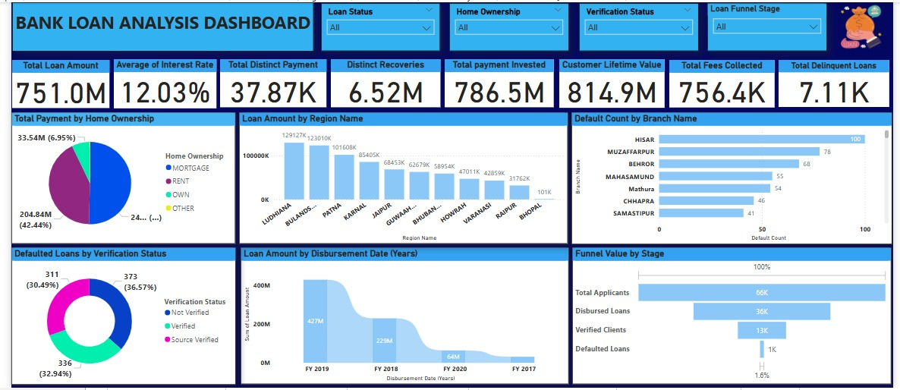
Bank loan analysis (power Bi)
DASHBOARDS

Slide 15
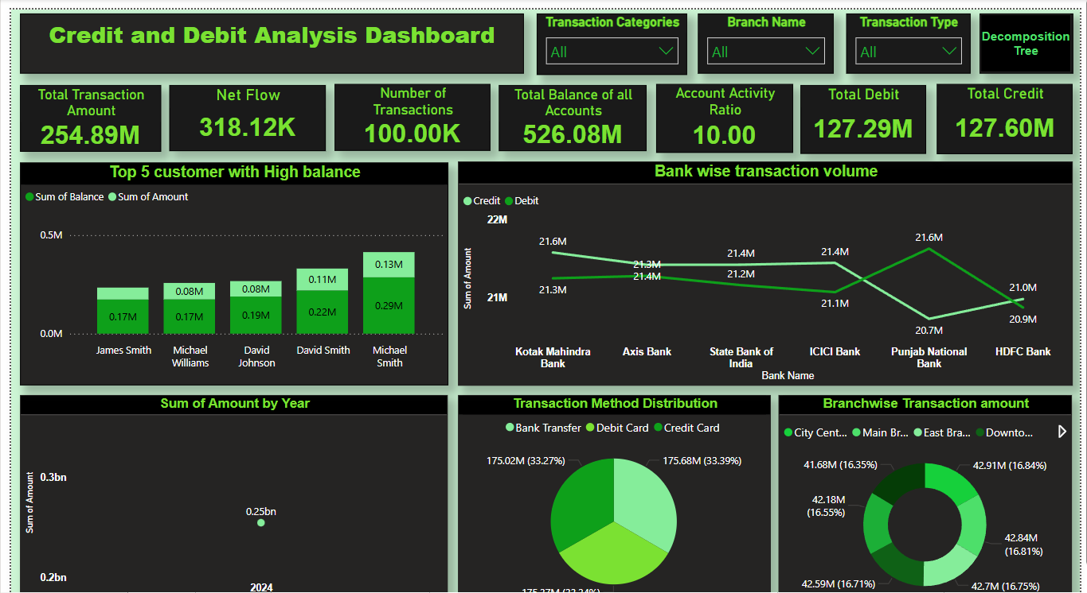
DEBIT AND CREDIT ANALYSIS (POWER BI)

Slide 16
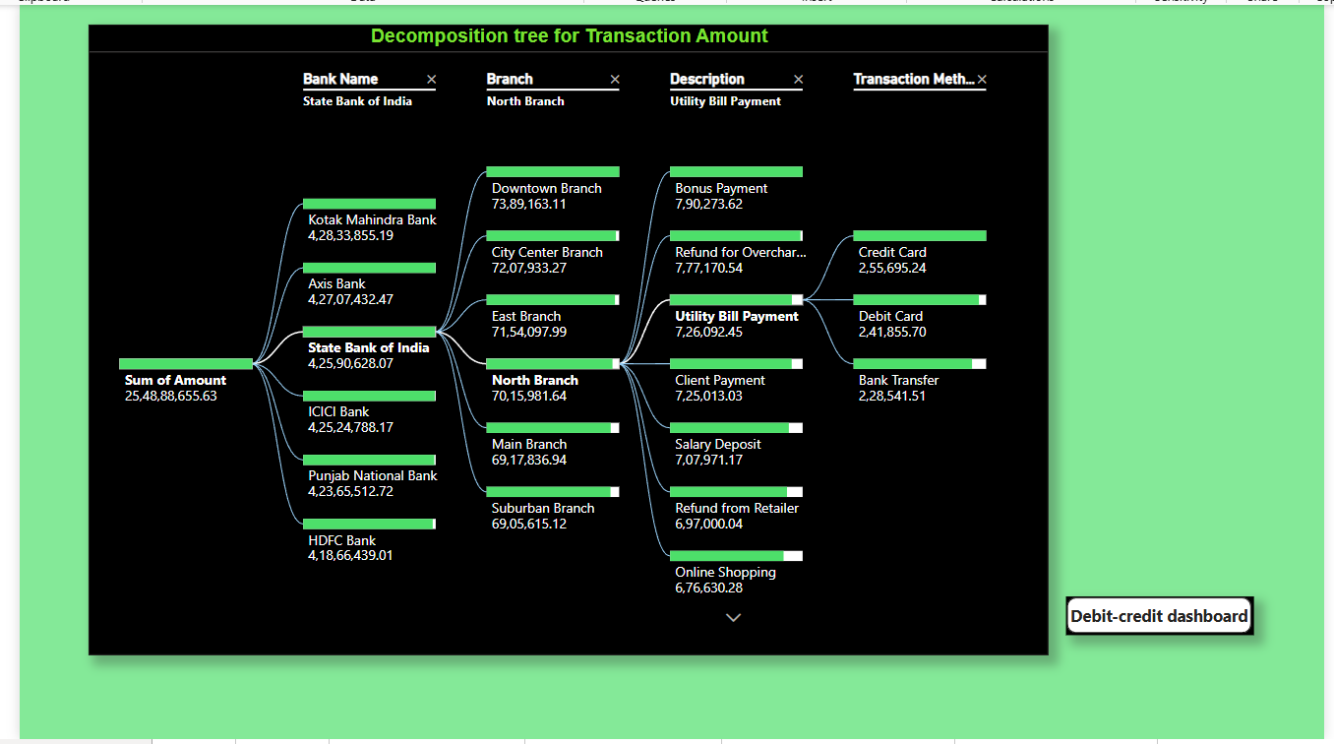
DECOMPOSITION TREE (POWER BI)

Slide 17
The Power BI Decomposition Tree for Transaction Amount provides a detailed breakdown of financial transactions across multiple dimensions including bank name, branch, transaction description, and payment method. The total transaction amount analyzed is approximately ₹2.55 billion (₹25,48,88,655.63). Among the banks, Kotak Mahindra Bank has the highest transaction value at around ₹4.28 billion, closely followed by Axis Bank, State Bank of India, ICICI Bank, Punjab National Bank, and HDFC Bank, all showcasing similarly high volumes above ₹4.18 billion.
Drilling down into the State Bank of India (SBI), which alone contributes over ₹4.25 billion, the decomposition is further broken by branches. The North Branch stands out with significant transaction volume (₹70.15 million) among others such as the Downtown, City Center, East, Main, and Suburban branches.
This decomposition tree serves as a powerful tool for stakeholders to identify key contributors to the total transaction volume and understand the distribution of banking activities across institutions, branches, payment types, and transaction purposes. It is especially useful for performance analysis, risk assessment, and strategic decision-making in financial operations.

Slide 18
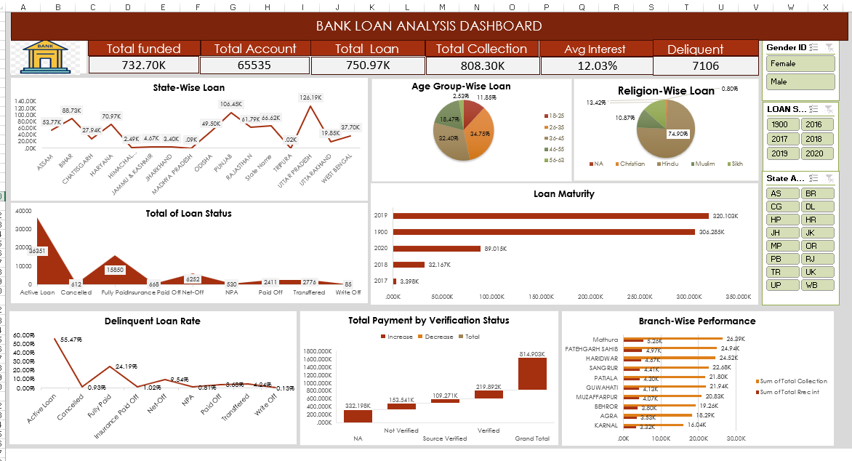
Bank Loan Analysis (Excel)

Slide 19
The Bank Loan Analysis Dashboard in the Excel visual provides a detailed snapshot of loan distribution, performance, and client segmentation across various dimensions. At the top, the high-level metrics indicate a total funded amount of ₹732.70K, with 65,535 total accounts and a total loan disbursed of ₹750.97K. The total collection stands at ₹808.30K, exceeding the total loan, suggesting effective recovery. The average interest rate is 12.03%, and there are 7,106 delinquent accounts, which signals a need for focused recovery efforts.
The state-wise loan distribution chart shows the highest funding in UTTARAKHAND (126.19K) and ODISHA (106.45K), followed by HARYANA and RAJASTHAN, while states like TRIPURA and JAMMU & KASHMIR show minimal disbursements. In terms of loan status, the majority of loans are still active (30,351), with a substantial number fully paid or canceled, and a smaller number written off (85) or transferred (2,776). The delinquency rate is highest for active loans (55.47%), pointing to a key area for intervention.
In terms of verification status, the highest total payments (₹814.90K) come from verified loans, especially source verified (₹219.89K) and not verified (₹153.54K), showing a preference or stronger performance from verified sources. Lastly, branch-wise performance shows Mathura as the top-performing branch in terms of collection (26.49K), followed by Fatehgarh Sahib, Haridwar, and Sangrur, indicating regional strengths in loan recovery and management.

Slide 20
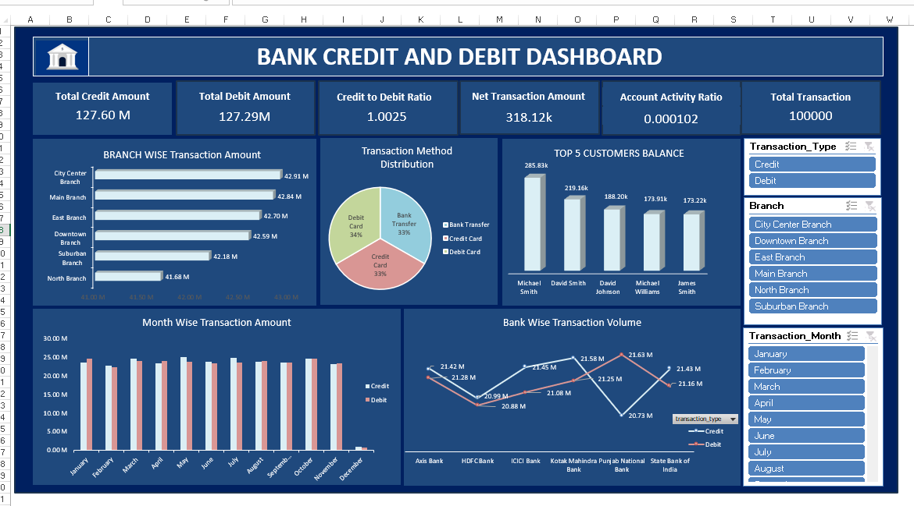
DEBIT AND CREDIT DASHBOARD (EXCEL)

Slide 21
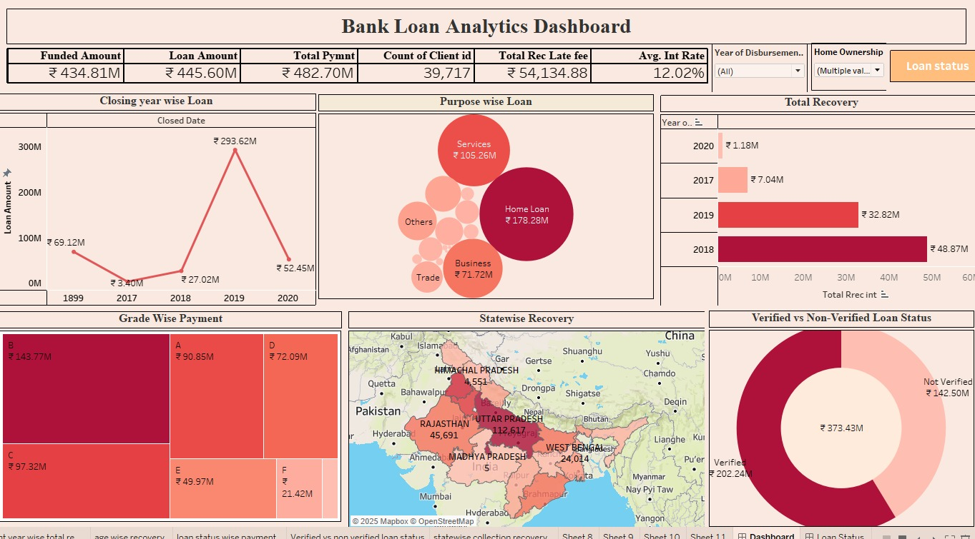
Bank loan analysis ( Tableau)

Slide 22
The Bank Loan Analytics Dashboard provides a comprehensive overview of various metrics related to loan performance and client behavior. At the top of the dashboard, we see key financial metrics, including a total funded amount of ₹434.81 million, total loan amount of ₹445.60 million, and total payment of ₹482.70 million, indicating that repayments have slightly exceeded the original loan disbursal. There are 39,717 clients, and the total late fee recovered is ₹54,134.88. The average interest rate stands at 12.02%, providing insight into the general lending conditions.
Dashboard illustrates that the majority of the loans, amounting to ₹202.24 million, are verified, while non-verified loans account for ₹142.50 million. This implies a stronger focus or preference towards verified loans, which may carry less risk. Overall, the dashboard offers valuable insights into loan performance, regional trends, and borrower behavior, supporting data-driven decision-making in banking operations.

Slide 23
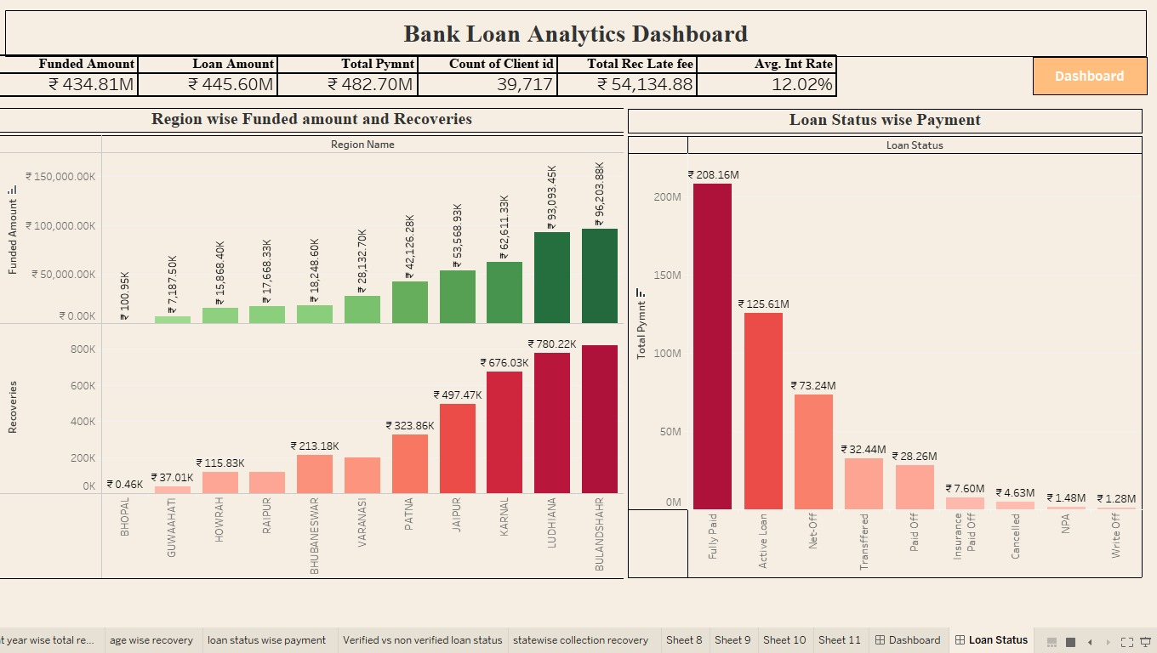
Bank loan analysis (Tableau)

Slide 24
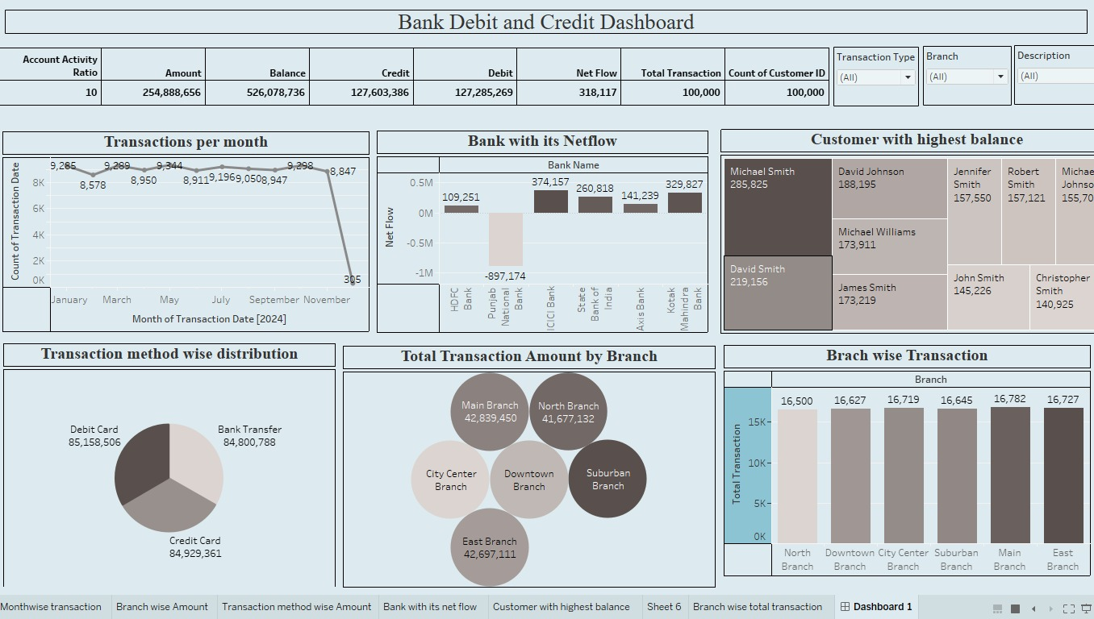
Bank debit and credit analysis (Tableau)

Slide 25
The Bank Debit and Credit Dashboard presents a comprehensive overview of banking transactions, customer behavior, and branch performance. At the top, the dashboard highlights key performance indicators: the Account Activity Ratio is 10, with a total transaction amount of ₹254.89 million, a total balance of ₹526.08 million, and nearly equal credit (₹127.60 million) and debit (₹127.29 million) flows, resulting in a net flow of ₹318,117. A total of 100,000 transactions have been made by an equal number of customers, indicating widespread account activity.
Monthly transaction trends are fairly stable throughout 2024, maintaining between 8,500 and 9,500 transactions per month from January to October. However, a sharp decline is observed in November, plummeting to just 305 transactions, possibly due to a data reporting cutoff or operational disruption.
Among banks, Punjab National Bank shows the most negative net flow (-₹897,174), suggesting more debits than credits, whereas banks like SBI (₹374,157) and Kotak Mahindra (₹329,827) lead in positive net flow. This indicates varying customer engagement and financial inflows across institutions.
Overall, this dashboard efficiently conveys transactional trends, customer segmentation, and operational strengths across different banks and branches, supporting data-driven decision-making in customer engagement and resource allocation.

Slide 26
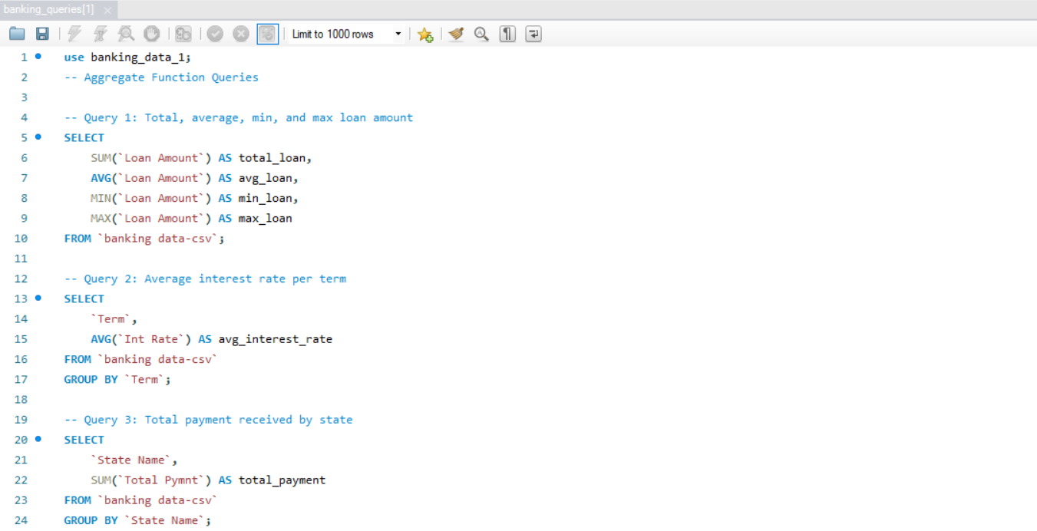
SQL QUERIES OF BANK LOAN ANALYSIS

Slide 27
The SQL queries shown in the above image are part of a banking data analysis project aimed at extracting key financial insights using aggregate functions. The first query calculates the total, average, minimum, and maximum loan amounts across the dataset, offering a clear overview of the scale and distribution of loans issued. The second query focuses on interest rates, calculating the average interest rate for each loan term, which is useful for comparing the financial impact of different loan durations. The third query shifts focus to geographic trends by summing up the total payments received from customers in each state, allowing analysts to assess regional repayment behavior and overall performance. Together, these queries provide a foundational analysis of loan metrics, interest costs, and payment distributions across various dimensions of the banking dataset.

Slide 28
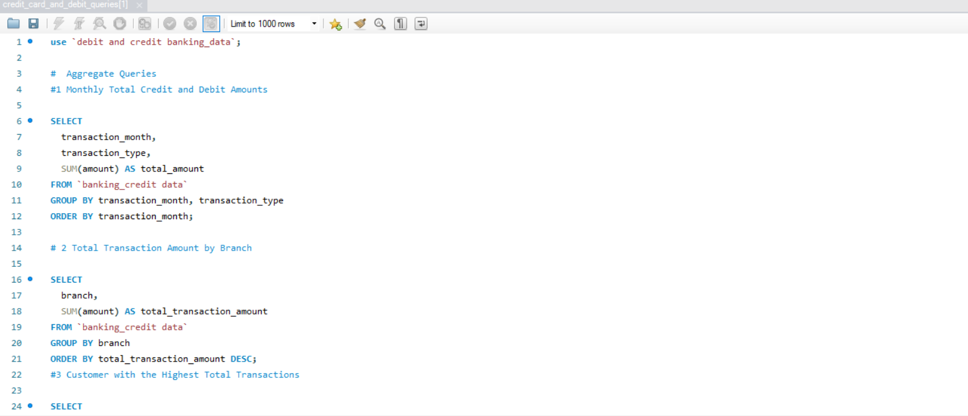
SQL QUERIES OF DEBIT AND CREDIT ANALYSIS

Slide 29
conclusion
The bank analytics project has enabled data-driven insights to support smarter and faster decision making in key areas such as customer segmentation, risk assessment ,and operational efficiency were significantly improved ,Our analytics models and dashboards provided actionable intelligence for both strategic and day to day operations . Ultimately the integration of these analytics empowers institutions to make informed decisions , driving efficiency and profitability. This project serves as a foundation for future initiatives in predictive analytics, automation and enhanced customer experience.

Slide 30
THANK YOU

